Slide 1

Unit-5
Android Programming
Databases and Content Providers
Introducing Android databases, Introducing SQLite, Content values and Cursors, Working with SQLite Databases, Creating Content Providers, using Content Providers, Adding search to your Application.
KLE Society’s College of BCA RLSI Belagavi

Slide 2
Introducing Android databases
SQLite is a open source SQL database that stores data to a text file on a device. Android comes in with built in SQLite database implementation.
We can perform so many operations on this data such as adding new data, updating, reading, and deleting this data. SQLite is an offline database that is locally stored in the user’s device and we do not have to create any connection to connect to this database.
KLE Society’s College of BCA RLSI Belagavi

Slide 3
SQLite supports all the relational database features. In order to access this database, you don't need to establish any kind of connections for it like JDBC,ODBC e.t.c
It is embedded in android by default. So, there is no need to perform any database setup or administration task.
KLE Society’s College of BCA RLSI Belagavi

Slide 4
Database – Package
The main package is android.database.sqlite that contains the classes to manage your own databases
KLE Society’s College of BCA RLSI Belagavi

Slide 5
Database – Creation
In order to create a database you just need to call this method openOrCreateDatabase with your database name and mode as a parameter. It returns an instance of SQLite database which you have to receive in your own object.
Its syntax is given below
SQLiteDatabase mydatabase=openOrCreateDatabase ("your database name",MODE_PRIVATE,null);
KLE Society’s College of BCA RLSI Belagavi

Slide 6
Database – Insertion
We can create table or insert data into table using execSQL method defined in SQLiteDatabase class. Its syntax is given below
mydatabase.execSQL("CREATE TABLE IF NOT EXISTS student(Username VARCHAR,Password VARCHAR);");
mydatabase.execSQL("INSERT INTO student VALUES('admin','admin');");
KLE Society’s College of BCA RLSI Belagavi

Slide 7
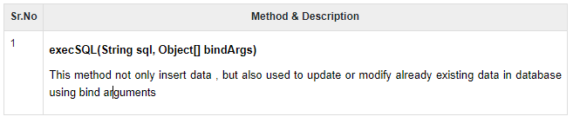
This will insert some values into our table in our database.
Another method that also does the same job but take some additional parameter is given below
KLE Society’s College of BCA RLSI Belagavi

Slide 8
Database – Fetching
We can retrieve anything from database using an object of the Cursor class. We will call a method of this class called rawQuery and it will return a resultset with the cursor pointing to the table. We can move the cursor forward and retrieve the data.
Cursor resultSet = mydatbase.rawQuery("Select * from TutorialsPoint",null);
resultSet.moveToFirst();
String username = resultSet.getString(0);
String password = resultSet.getString(1);
KLE Society’s College of BCA RLSI Belagavi

Slide 9
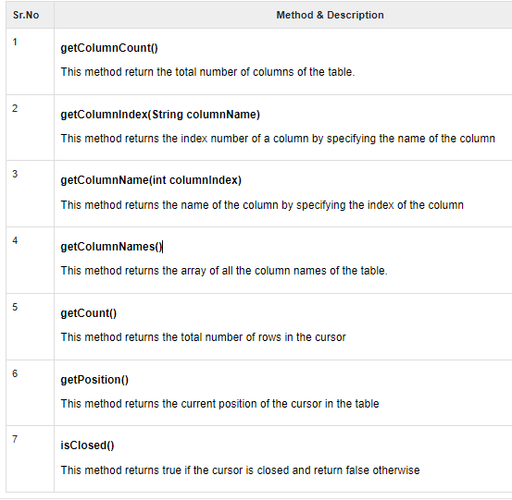
There are other functions available in the Cursor class that allows us to effectively retrieve the data. That includes
KLE Society’s College of BCA RLSI Belagavi

Slide 10
SQLiteOpenHelper class
SQLiteOpenHelper class provides the functionality to use the SQLite database
The android.database.sqlite.SQLiteOpenHelper class is used for database creation and version management. For performing any database operation, you have to provide the implementation of onCreate() and onUpgrade() methods of SQLiteOpenHelper class.
KLE Society’s College of BCA RLSI Belagavi

Slide 11
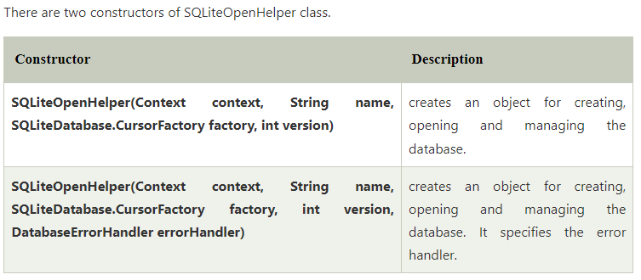
KLE Society’s College of BCA RLSI Belagavi

Slide 12
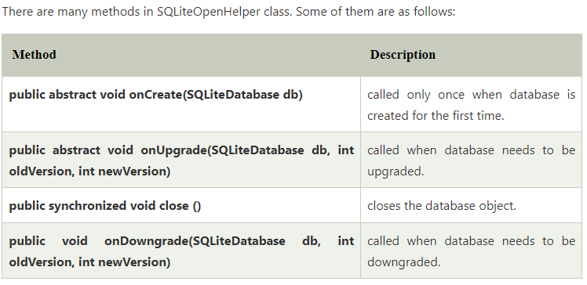
KLE Society’s College of BCA RLSI Belagavi

Slide 13
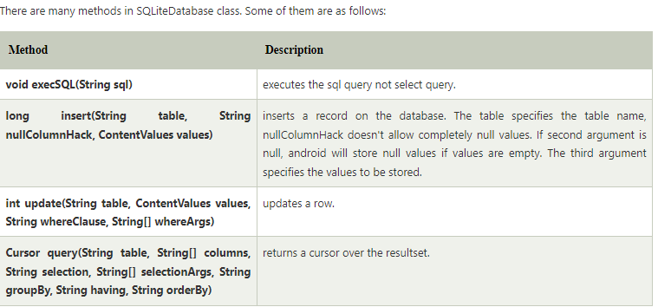
SQLiteDatabase class
It contains methods to be performed on sqlite database such as create, update, delete, select etc.
KLE Society’s College of BCA RLSI Belagavi

Slide 14
Cursors And Content Values
ContentValues are used to insert new rows into tables. Each Content Values object represents a single table row as a map of column names to values.
Queries in Android are returned as Cursor objects. Rather than extracting and returning a copy of the result values, Cursors are pointers to the result set within the underlying data. Cursors provide a managed way of controlling your position (row) in the result set of a database query
KLE Society’s College of BCA RLSI Belagavi

Slide 15
The Cursor class includes a number of navigation functions including, but not limited to, the following:
> moveToFirst Moves the cursor to the first row in the query result
> moveToNext Moves the cursor to the next row
> moveToPrevious Moves the cursor to the previous row
> getCount Returns the number of rows in the result set
> getColumnIndexOrThrow Returns the index for the column with the specified name (throwing an exception if no column exists with that name)
> getColumnName Returns the name of the specified column index
> getColumnNames Returns a string array of all the column names in the current Cursor
> moveToPosition Moves the Cursor to the specified row
> getPosition Returns the current Cursor position
KLE Society’s College of BCA RLSI Belagavi

Slide 16
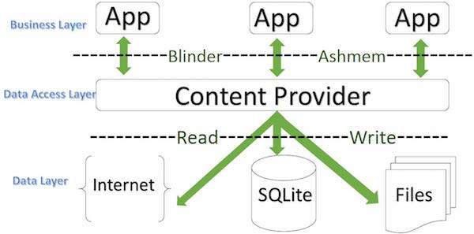
Creating Content Providers
A content provider component supplies data from one application to others on request. Such requests are handled by the methods of the ContentResolver class.
A content provider can use different ways to store its data and the data can be stored in a database, in files, or even over a network.
KLE Society’s College of BCA RLSI Belagavi

Slide 17
Content providers let you centralize content in one place and have many different applications access it as needed.
A content provider behaves very much like a database where you can query it, edit its content, as well as add or delete content using insert(), update(), delete(), and query() methods. In most cases this data is stored in an SQlite database.
A content provider is implemented as a subclass of ContentProvider class and must implement a standard set of APIs that enable other applications to perform transactions.
public class My Application extends ContentProvider
{
}
KLE Society’s College of BCA RLSI Belagavi

Slide 18
Content URIs
Content URIs are the uniform resource identifiers that identify the data in the content providers.
A content URI includes two things:
Authority that is the symbolic name of the Provider.
Path that is a name that points towards the data. Every content provider methods have an argument which is URI.
Let’s understand the Content Provider URI:
content://<authority>/<path>/<optional_id>
content:// – It’s always present, and is the scheme portion of the URI.
authority – It is the unique name of the content provider, like photos, contacts. It’s a string that can identify the whole content provider.
KLE Society’s College of BCA RLSI Belagavi

Slide 19
path – It is often used to identify some or the other data of the provider. The path is mostly used to identify individual tables.
optional_id – id is used to access a single particular record of a file. We use this only in cases where we need to access only a particular record and not the complete file.
KLE Society’s College of BCA RLSI Belagavi

Slide 20
Access Data from Content Provider
To access a data from content provider, we need to use ContentResolver object in our application to communicate with the provider as a client. The ContentResolver object will communicate with the provider object (ContentProvider) which is implemented by an instance of class.
Generally, in android to send a request from UI to ContentResolver we have another object called CursorLoader which is used to run the query asynchronously in background. In android application, the UI components such as Activity or Fragment will call a CursorLoader to query and get a required data from ContentProvider using ContentResolver.
The ContentProvider object will receive data requests from the client, performs the requested actions (create, update, delete, retrieve) and return the result.
KLE Society’s College of BCA RLSI Belagavi

Slide 21
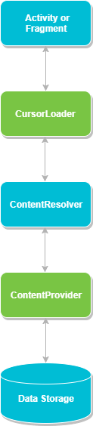
KLE Society’s College of BCA RLSI Belagavi

Slide 22
Create Content Provider
This involves number of simple steps to create your own content provider.
First of all you need to create a Content Provider class that extends the ContentProviderbaseclass.
Second, you need to define your content provider URI address which will be used to access the content.
Next you will need to create your own database to keep the content. Usually, Android uses SQLite database and framework needs to override onCreate() method which will use SQLite Open Helper method to create or open the provider's database. When your application is launched, the onCreate() handler of each of its Content Providers is called on the main application thread.
Next you will have to implement Content Provider queries to perform different database specific operations.
Finally register your Content Provider in your activity file using <provider> tag.
KLE Society’s College of BCA RLSI Belagavi

Slide 23
Here is the list of methods which you need to override in Content Provider class to have your Content Provider working −
onCreate() This method is called when the provider is started.
query() This method receives a request from a client. The result is returned as a Cursor object.
insert()This method inserts a new record into the content provider.
delete() This method deletes an existing record from the content provider.
update() This method updates an existing record from the content provider.
getType() This method returns the MIME type of the data at the given URI.
KLE Society’s College of BCA RLSI Belagavi

Slide 24
Example of android SQLite database
public class MainActivity extends AppCompatActivity { EditText Rollno,Name,Marks; Button Insert,Delete,Update,View,ViewAll; SQLiteDatabase db; protected void onCreate(Bundle savedInstanceState) { super.onCreate(savedInstanceState); setContentView(R.layout.activity_main); Rollno=(EditText)findViewById(R.id.Rollno); Name=(EditText)findViewById(R.id.Name); Marks=(EditText)findViewById(R.id.Marks); Insert=(Button)findViewById(R.id.Insert); Delete=(Button)findViewById(R.id.Delete); Update=(Button)findViewById(R.id.Update); ViewAll=(Button)findViewById(R.id.ViewAll); db=openOrCreateDatabase("StudentDB", Context.MODE_PRIVATE, null); db.execSQL("CREATE TABLE IF NOT EXISTS student(rollno VARCHAR,name VARCHAR," + "marks VARCHAR);"); }
KLE Society’s College of BCA RLSI Belagavi

Slide 25
public void InsertRecord(View view)
{
if(Rollno.getText().toString().trim().length()==0|| Name.getText().toString().trim().length()==0|| Marks.getText().toString().trim().length()==0) { showMessage("Error", "Please enter all values"); return; } db.execSQL("INSERT INTO student VALUES('"+Rollno.getText()+"','"+Name.getText()+ "','"+Marks.getText()+"');"); showMessage("Success", "Record added"); clearText(); }
KLE Society’s College of BCA RLSI Belagavi

Slide 26
public void Deleterecord(View view)
{
if(Rollno.getText().toString().trim().length()==0) { showMessage("Error", "Please enter Rollno"); return; } Cursor c=db.rawQuery("SELECT * FROM student WHERE rollno='"+Rollno.getText()+"'", null); if(c.moveToFirst()) { db.execSQL("DELETE FROM student WHERE rollno='"+Rollno.getText()+"'"); showMessage("Success", "Record Deleted"); } else { showMessage("Error", "Invalid Rollno"); } clearText(); }
KLE Society’s College of BCA RLSI Belagavi

Slide 27
public void Updaterecord(View view)
{
if(Rollno.getText().toString().trim().length()==0) { showMessage("Error", "Please enter Rollno"); return; } Cursor c=db.rawQuery("SELECT * FROM student WHERE rollno='"+Rollno.getText()+"'", null); if(c.moveToFirst()) { db.execSQL("UPDATE student SET name='" + Name.getText() + "',marks='" + Marks.getText() + "' WHERE rollno='"+Rollno.getText()+"'"); showMessage("Success", "Record Modified"); } else { showMessage("Error", "Invalid Rollno"); } clearText();
}
KLE Society’s College of BCA RLSI Belagavi

Slide 28
Public void DisplayRecord(View view)
{
Cursor c=db.rawQuery("SELECT * FROM student", null); if(c.getCount()==0) { showMessage("Error", "No records found"); return; } StringBuffer buffer=new StringBuffer(); while(c.moveToNext()) { buffer.append("Rollno: "+c.getString(0)+"\n"); buffer.append("Name: "+c.getString(1)+"\n"); buffer.append("Marks: "+c.getString(2)+"\n\n"); } showMessage("Student Details", buffer.toString());
}
KLE Society’s College of BCA RLSI Belagavi

Slide 29
public void showMessage(String title,String message) { AlertDialog.Builder builder=new AlertDialog.Builder(this); builder.setCancelable(true); builder.setTitle(title); builder.setMessage(message); builder.show(); } public void clearText() { Rollno.setText(""); Name.setText(""); Marks.setText(""); Rollno.requestFocus(); } }
KLE Society’s College of BCA RLSI Belagavi

Slide 30
Adding search to your Application
Local vs. global search
There are essentially two kinds of search in Android:
local search and
global search
Local search enables users to search content of the currently visible app. Local search is appropriate for nearly every type of app. A recipe app could offer users to search for words in the title of the recipes or within the list of ingredients. Local search is strictly limited to the app offering it and it's results are not visible outside of the app.
Global search on the other hand makes the content also accessible from within the Quick Search Box on the home screen. Android uses multiple data source for global search and your app can be one of it. In the next screen taken on a tablet you can see the results of a Google search on the left and some results from apps or for app titles on the right.
KLE Society’s College of BCA RLSI Belagavi

Slide 31
<?xml version="1.0" encoding="utf-8"?> <LinearLayout xmlns:android="http://schemas.android.com/apk/res/android" xmlns:tools="http://schemas.android.com/tools"
android:layout_width="match_parent"
android:layout_height="match_parent"
android:orientation="vertical"
android:gravity="center"
tools:context=".MainActivity">
<EditText android:layout_width="match_parent"
android:layout_height="wrap_content"
android:id="@+id/editText"
android:layout_centerInParent="true" />
<Button android:layout_width="match_parent“
android:layout_height="wrap_content"
android:id="@+id/btnSearch"
android:text="Search"/>
</LinearLayout>
KLE Society’s College of BCA RLSI Belagavi

Slide 32
public class MainActivity extends AppCompatActivity {
EditText editText;
Button btnSearch;
@Override protected void onCreate(Bundle savedInstanceState) {
super.onCreate(savedInstanceState);
setContentView(R.layout.activity_main);
editText = findViewById(R.id.editText);
btnSearch = findViewById(R.id.btnSearch);
btnSearch.setOnClickListener(new View.OnClickListener()
{
@Override
public void onClick(View v)
{
Intent intent = new Intent(Intent.ACTION_WEB_SEARCH);
String term = editText.getText().toString();
intent.putExtra(SearchManager.QUERY, term);
startActivity(intent); } }); } }
KLE Society’s College of BCA RLSI Belagavi

Slide 33
<?xml version="1.0" encoding="utf-8"?>
<manifest xmlns:android="http://schemas.android.com/apk/res/android" package="app.com.sample">
<uses-permission android:name="android.permission.INTERNET"/>
<application android:allowBackup="true"
android:icon="@mipmap/ic_launcher"
android:label="@string/app_name"
android:roundIcon="@mipmap/ic_launcher_round"
android:supportsRtl="true"
android:theme="@style/AppTheme">
<activity android:name=".MainActivity">
<intent-filter>
<action android:name="android.intent.action.MAIN" />
<category android:name="android.intent.category.LAUNCHER" />
</intent-filter>
</activity>
</application>
</manifest>

